Slide 1
Solving mutual exclusion by using entangled Qbits
Mohammad Rastegari proff: Dr.Rahmani

Slide 2
Outline
Introduction to Quantum computer
Qbit
Multiple Qbit
Quantum gate
Quantum circuit
Entanglement
Solving mutual exclusion by entangled system

Slide 3
Introduction to Quantum Computer

Slide 4
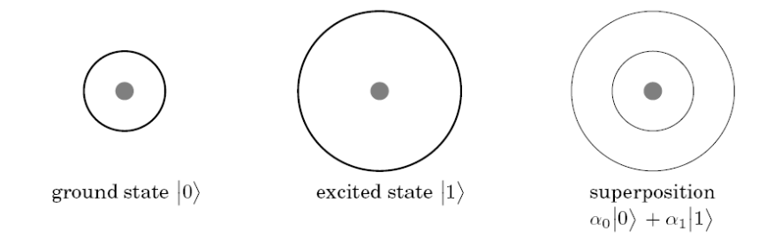
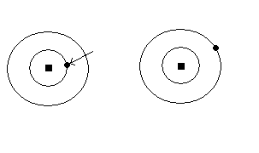
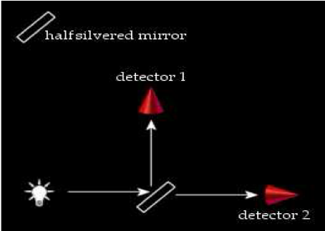
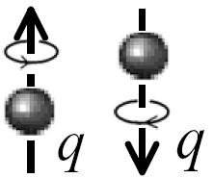
Qbit
Some phenomena in quantum physic
Tow state quantum system
Hydrogen atom
Polarization of photon
Electron’s spin

Slide 5
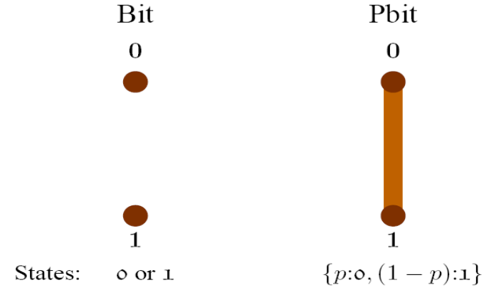
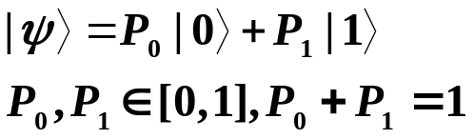
Qbit(cont.)
Qbit as black box
We should measure it
After measurement it is constant
Is it probabilistic bit?
It means that can we
represent it by
Is it a fuzzy bit?

Slide 6
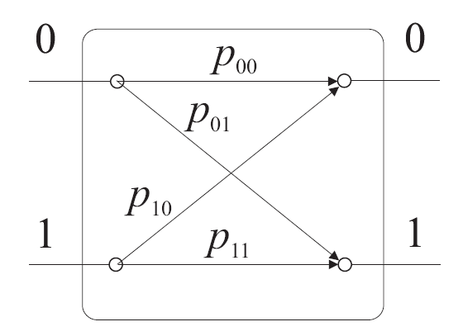
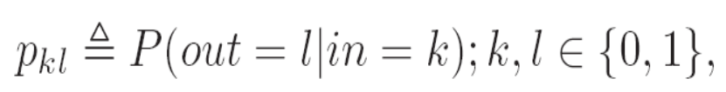

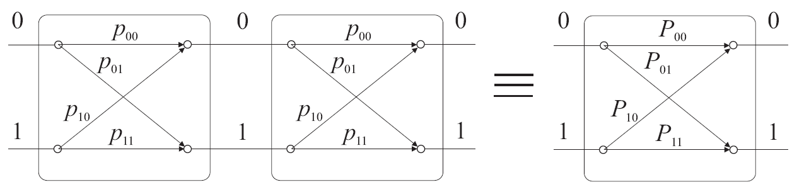
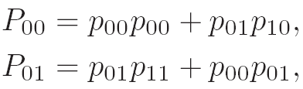
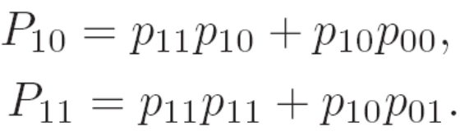


Qbit(cont.)
Explain with classical probability

Slide 7

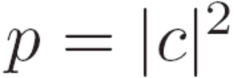

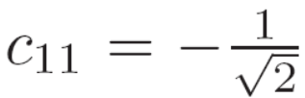
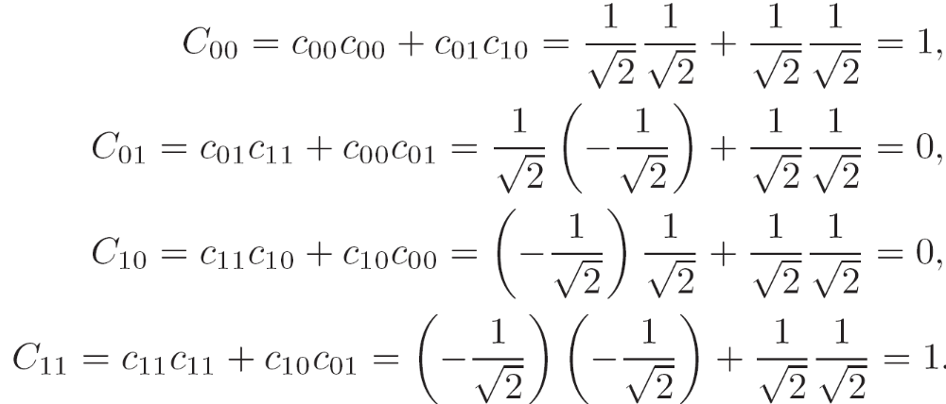
Qbit(cont.)
Now we replace P with
Classical probability can obtain by

Slide 8
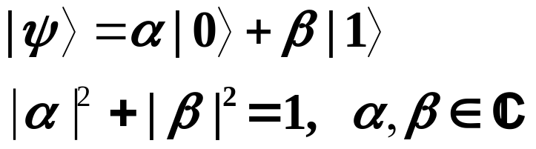
Qbit(cont.)
We just showed that classical probability is not enough for describing this phenomena
Now we just want to say that we can describe this phenomena by

Slide 9
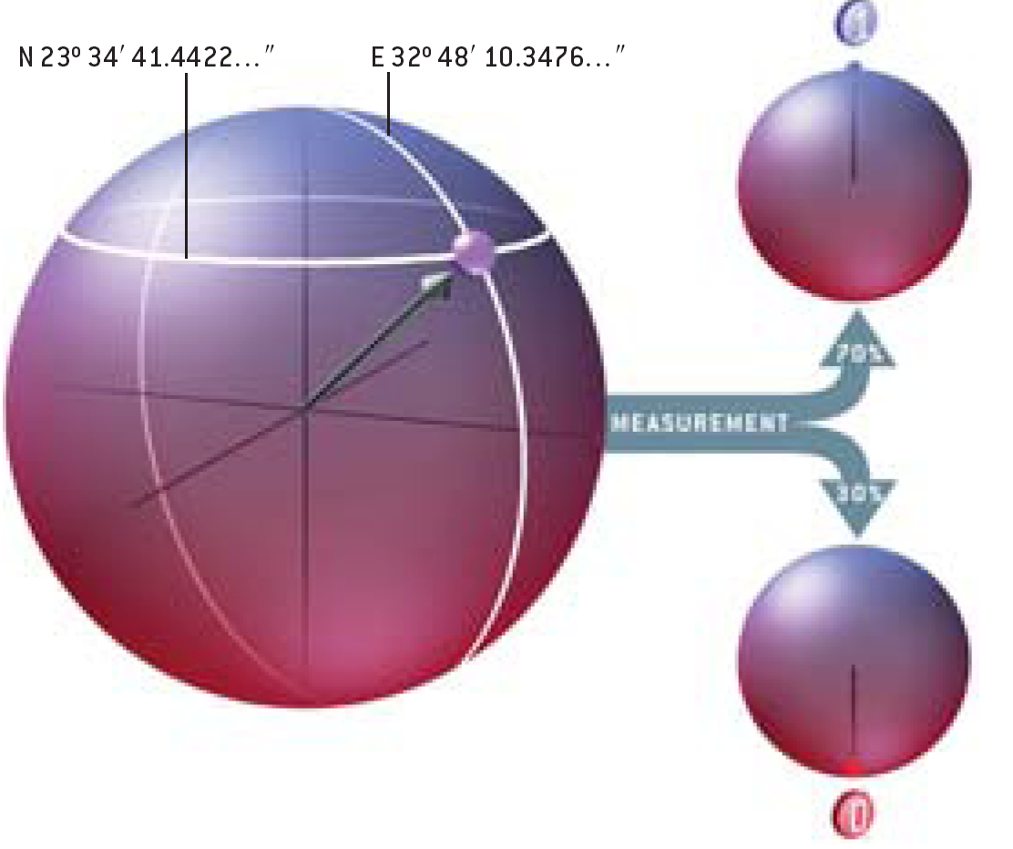
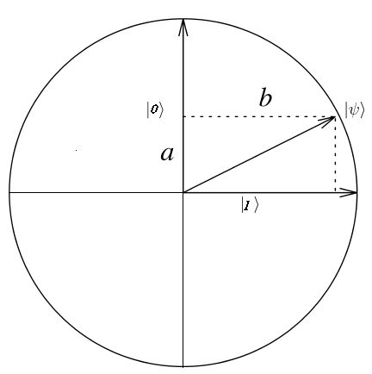
Qbit(cont.)
Geometrically visualization :
For real number
For complex number
(Bloch sphere)

Slide 10
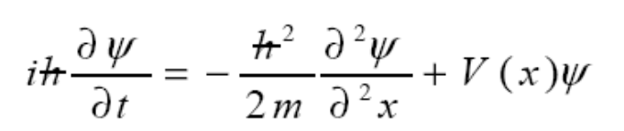

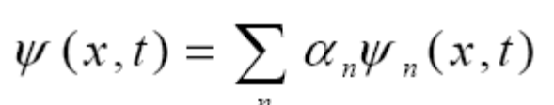
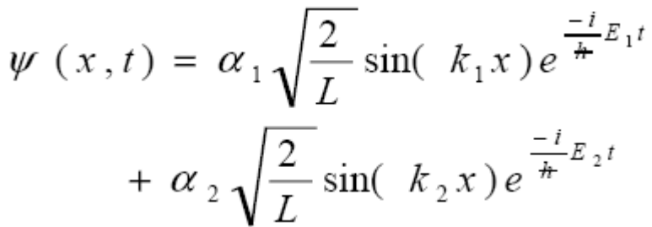
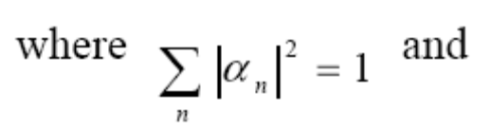
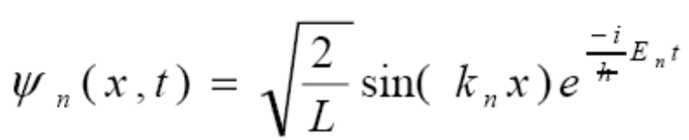
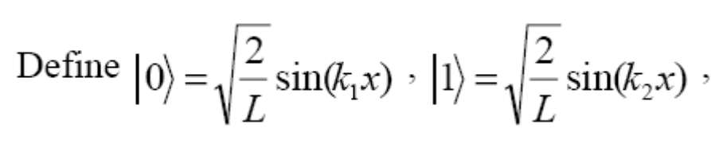
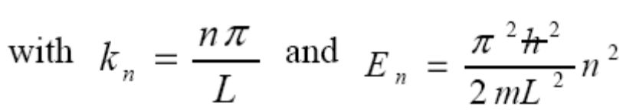
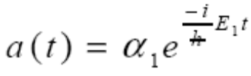



Qbit(cont.)
The exact way to show how we arrived to this form for representing a qbit comes from Schrödinger equation for describing wave-particle property

Slide 11
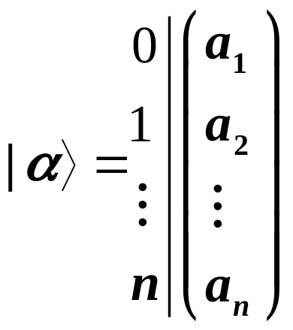
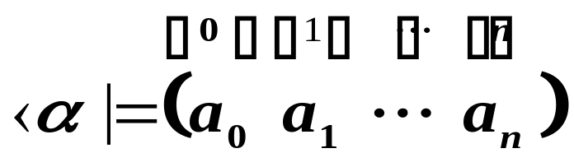
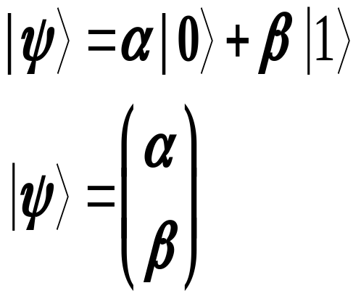
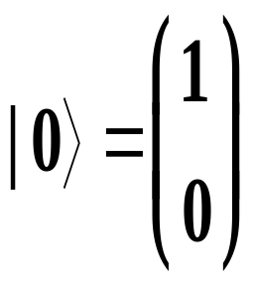
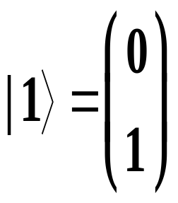
Dirac notation
Bra
Ket

Slide 12
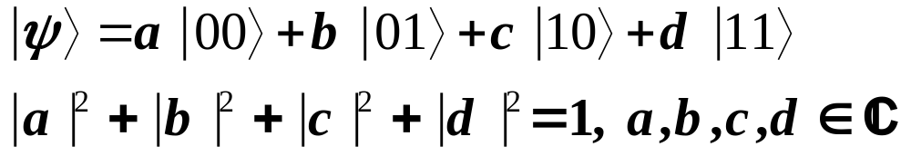
Multiple qbit
We represent the state that two qbit get together by:
Hilbert space : a space that define on complex vector and closed by inner product,
for example : U={|0>,|1>} or V={|00>,|01>,|10>,|11>}

Slide 13





Multiple qbit
Tensor product of two spaces: tensor product of tow hilbert space U and V indicate by U V, is a vector space include all of pair vector
and the base vectors of this space are set of all pair of base vectors in U and V.
we can show the tensor produt of |a> and |b> by
Inner product:
Outer product:

Slide 14
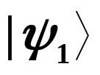

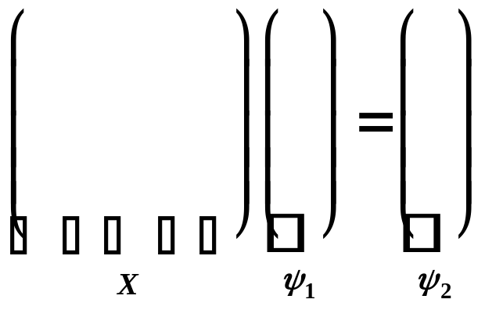
Operator
Matrix oprator:
as we told we can represent a state by a vector,
if given n-by-n matrix X product with vector the result will be another vector .
.

Slide 15
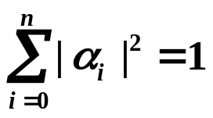

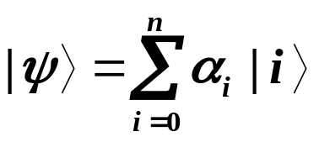
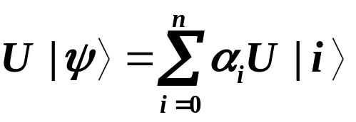
Operator
If this operator maintain in a normal state,
it mean , we call it unitary operator.
An operator M is unitary iff .
If and U be an unitary operator then

Slide 16
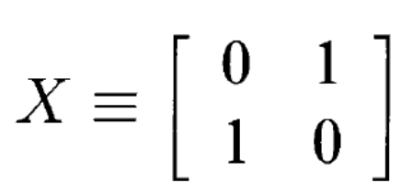
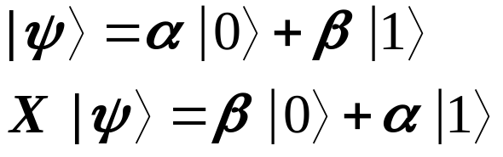


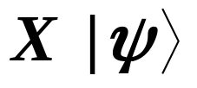
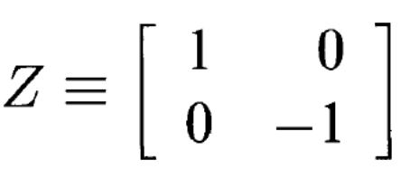

Quantum gate
Single operand (qbit) gates:
Quantum NOT gate X :
Quantum Z gate:

Slide 17
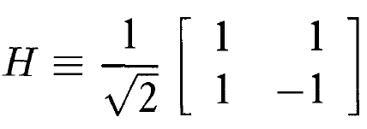
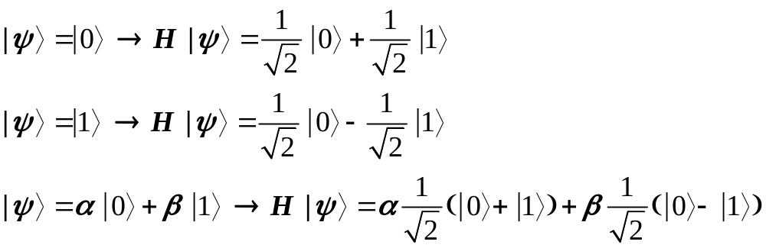
Quantum gate
Hadamard gate H :
usually we use of this gate to make a super position state when we are in a base state or up-side-down .

Slide 18
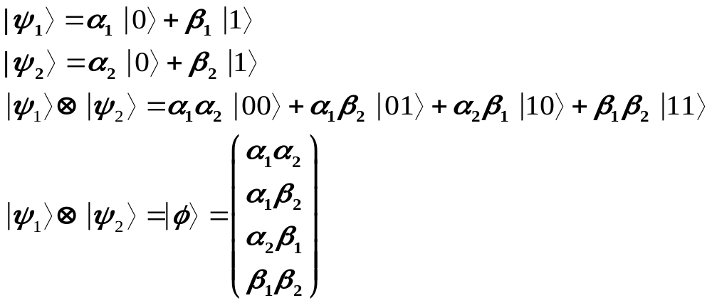
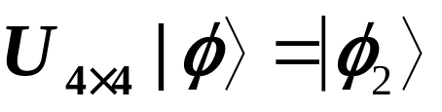
Quantum gate
Multiple operand (qbit) quantum gate:
As we had in classical gate like AND, OR, NAND,NOR,… that operate on tow or more bit, there are quantum gate that operate on tow or more qbit.

Slide 19
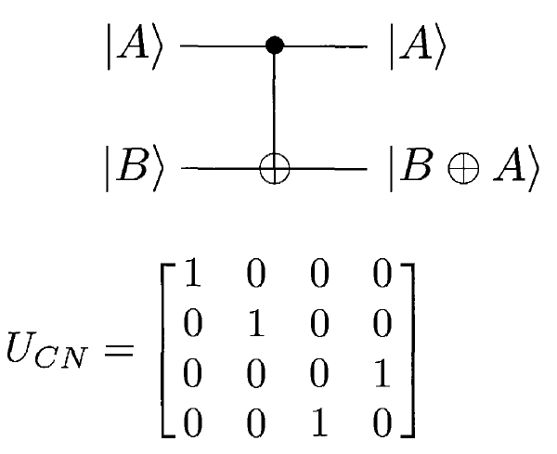



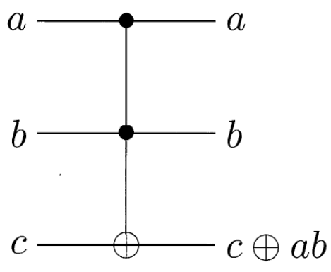
Quantum gate
Controlled-NOT gate CNOT :
Toffoli gate:

Slide 20
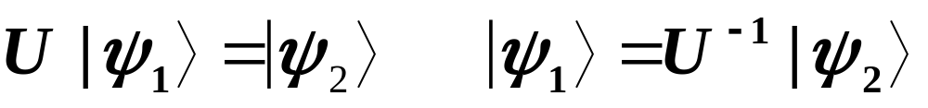
Quantum gate
Reversibility : in classical gate like AND we could not with given output determine what was exact input but in quantum gate we always can. Because U is a unitary matrix U is reversible and we have:

Slide 21
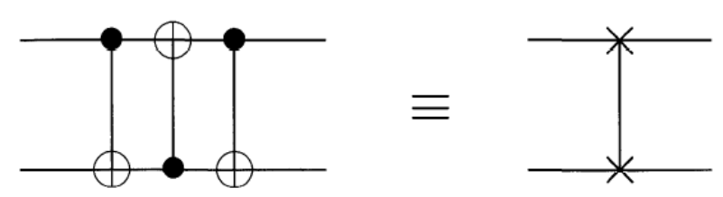
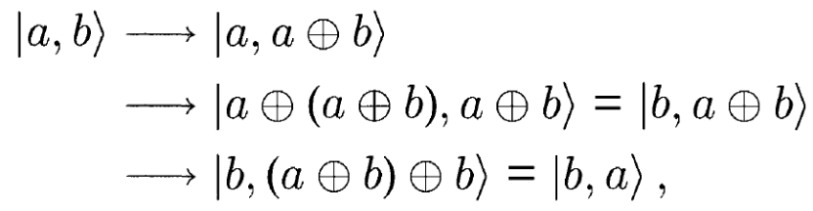

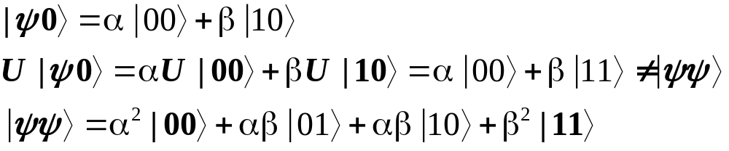
Quantum Circuit
We can with combining several quantum gate design a quantum circuit for example we design circuit of swapping :
Some different with classical circuit:
Feedback is illegal (quantum circuit is acyclic)
FANIN is illegal because it’s equivalent with bitwise-OR which is irreversible.
FANOUT is illegal(no-clloning) we can not get a copy from a qbit in superposition it means that should be a gate U that .

Slide 22






Quantum circuit
No-cloning is not stand for basic states.
A gate for measurement

Slide 23

Quantum circuit
Power of quantum computation vs. classical computation:
As we know in Boolean algebra NAND or NOR operator is universal operator, if we can construct these gate we can show that quantum computer has at least power of classical computer,
Quantum NAND gate:

Slide 24








Quantum Entanglement
Entanglement (Bell state)(EPR pair)

Slide 25
Mutual exclusion in distributed system
As we know in there was three algorithm for mutual exclusion:
Centralized
Distributed
Token ring

Slide 26

Mutual exclusion in distributed system
If we assign a qbit for each node that these qbits be entangled in this form:
We can check if we can enter to critical section or not, by measuring qbit in each node.

Slide 27

Mutual exclusion in distributed system
In our protocol, if after measurement we get 1 we are legal to enter to critical section but if we get 0 we should determine that if really we are illegal to enter to the critical section or not, it means that , may any node is not be in critical section but we measure 0.

Slide 28
Mutual exclusion in distributed system
For solving this problem we can after measure 0 request the state of whole of system it means that can determine that which node’s qbit is 1 now , and then we can send a message to that system and ask it , is it in critial section or not?
We exactly describe it by pseudo code

Slide 29
1-Enter(node(k)){
2- Chq=Measurement node(k).qbit;
3- If (chq= =0){
4- I=request state of system;
5- Ans=message(node(k),node(i))
6- If (ans = = false){
7- Broad state k;
8- Delete node(i).queue;
9- node(k).critical=true;
10- }else wait;
11- }else node(k).critical=true;
12-}
Critical section();
1-Exit(node(k)){
2- if (node(k).queue[front]<> empty){
node(k).critical=false;
node(node(k).queue[front]).up;
}
else{
Broad new entangled qbits;
3- Node(k).critical=false;
}
4-}
Bool Message(node(src),node(trg)){
If (node(trg).queue<> empty ) return true;
Node(trg).queue[rear]=src;
If (node(trg).critical= = true) return true;
Else return false;
}

Slide 30
With this algorithm we can not maintain priority of request for critical section. For solving this problem maintain the queue and transfer it in nodes which wants to enter to critical section.
Enter(node(k)){
Chq=Measurement node(k).qbit(k);
If (chq= =0){
I=position of that bit in register which is 1;
Ans=message(node(k),node(i))
If (ans = = false){
Node(i).registervalue=k;
Transfer {node(i).queue-k} to node(k).queue;
node(k).critical=true;
}else node(k).down;
}else node(k).critical=true;
}
Bool Message(node(src),node(trg)){
trg= node(trg).registervalue
Node(trg).queue[rear]=src;
if (node(trg).critical < >
false)||(node(trg).queue[front] < >
src) return true;
Else
return false;
}

Slide 31

comparison
Entangled qbit 1 to 2 1 to 2 sensitive with environment

